Slide 1


Regression and Data Simulation
Statistical Learning & Data Analysis
Master in Data Science
Department of Engineering
Prepared by :
Shurouq Abuewaili Mona AlRozzi Mahmoud Nweija
Supervised by :
Prof.Roberta Siciliano
Prof.Emiliano Del Gobbo

Slide 2
Table of contents
01
03
02
04
DATASET SIMULATION AND LINEAR REGRESSION
NON-LINEAR REGRESSION AND BIAS-VARIANCE EXPERIMENT
SHRINKAGE AND REGULARIZATION
Conclusion

Slide 3
Goals of the Assignment
Simulate data with known structure
Compare linear, regularized, and non-linear models
Understand model stability and bias–variance trade-off.

Slide 4
01
DATASET SIMULATION AND LINEAR REGRESSION

Slide 5
Data Simulation
There are many methods for generating synthetic data depending on the modeling goal.
Data can be Generated by
Linear Function
to study linear relationships
Non-linear function
to analyze more complex patterns

Slide 6
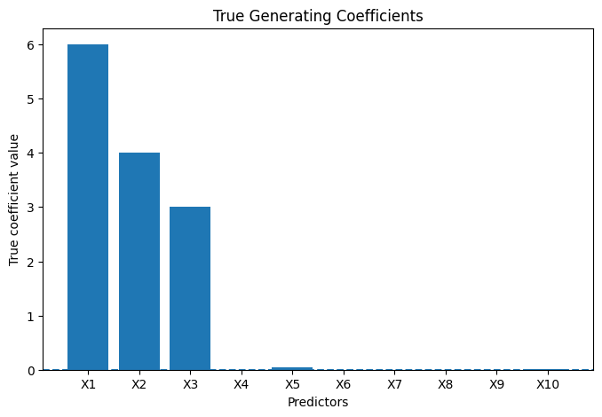
Data Simulation (Linear Case)
n=300, p=10
Few strong predictors, others weak or null.
Added Gaussian noise.
Generate target using a linear model:
y=Xβ+ε
Notes:
We simulated data where we know the truth, allowing us to check if models recover the real signal.
We simulated data with ten predictors, but only a few have strong true effects. 3This plot shows the true coefficients used to generate the data. Most variables have coefficients close to zero, representing irrelevant predictors, while a small subset has large effects.

Slide 7
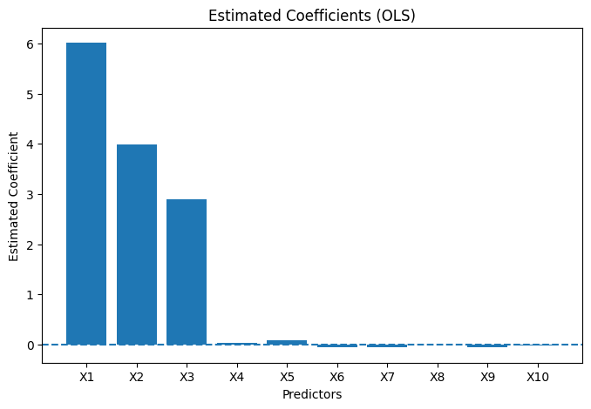
Linear Regression Results
Ordinary Least Squares regression successfully identifies the predictors with strong true effects. However, several predictors with no real influence still receive non-zero estimated coefficients, showing the sensitivity of linear regression to noise and irrelevant variables.
Notes:
"Using ordinary least squares, we estimated the regression coefficients.
Some predictors appear statistically significant, and they mostly correspond to the true strong variables.
However, some noise variables also show non-zero coefficients due to randomness."

Slide 8
Regression Diagnostics
Regression diagnostics were used to assess the validity and stability of the linear model. Residual analysis and influence measures reveal the presence of observations that may strongly affect coefficient estimates, highlighting that statistical significance alone is not sufficient to guarantee model reliability.
Notes:
We simulated data where we know the truth, allowing us to check if models recover the real signal.
We simulated data with ten predictors, but only a few have strong true effects. 3This plot shows the true coefficients used to generate the data. Most variables have coefficients close to zero, representing irrelevant predictors, while a small subset has large effects.

Slide 9
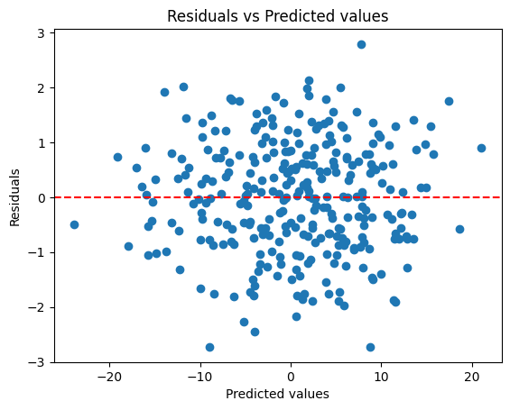
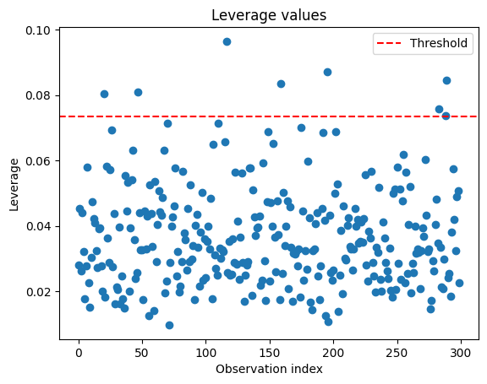
Regression Diagnostics
Notes:
Residuals vs predicted values plot
The dots are randomly scattered around the red zero line
There is no clear pattern (no curve, no wave, no funnel shape)
Residuals are spread both above and below zero
The model is behaving well
Relationship looks linear
No obvious heteroscedasticity
Leverage values plot
Observation Index (X-axis): This represents each individual row or data point in your dataset (from 0 to roughly 300).
Leverage (Y-axis): This value (often denoted as hii) ranges from 1/n to 1. Higher values indicate the point is an outlier in the predictor space.
Red Dashed Line (Threshold): This is a critical diagnostic boundary. A common rule of thumb for this threshold is 3p/n or 2p/n (where p is the number of predictors and n is the sample size).
About 8 points have high leverage, meaning they have a stronger-than-average impact on the model's "slope."

Slide 10
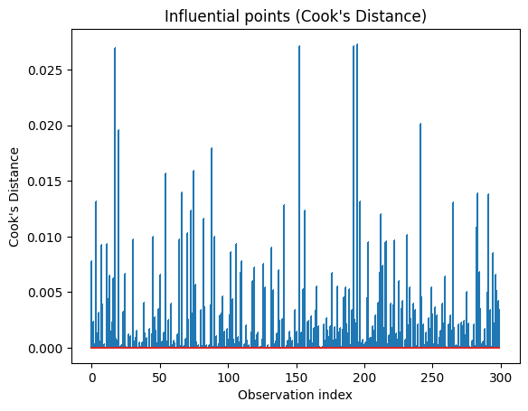
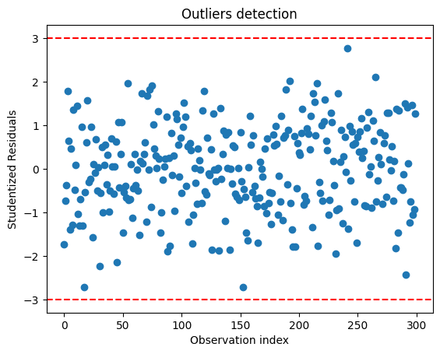
Regression Diagnostics
Notes:
Influential points plot
Most observations have very low Cook’s Distance values, indicating that they have minimal influence on the regression model.
The model appears stable, as no single observation dominates the regression results.
A few observations show relatively higher Cook’s Distance values, suggesting the presence of potentially influential points.
These influential points may slightly affect model parameters, but they do not critically distort the overall model.
No Cook’s Distance values exceed critical thresholds (e.g., 𝐷>1), indicating the absence of highly influential outliers.
Overall, the regression model is robust and not overly sensitive to individual data points.
Outlier detection plot
Almost all points fall within the red dashed lines at -3 and 3.

Slide 11
02
SHRINKAGE AND REGULARIZATION

Slide 12
Shrinkage and Regularization
Control model complexity and reduce overfitting.
Penalize large coefficients to improve stability and generalization.
Handle multicollinearity and improve interpretability.
Enable feature selection and balance fit vs simplicity.
Methods used:
Ridge (L2): shrinks coefficients, keeps all variables.
Lasso (L1): shrinks and removes irrelevant variables.
Elastic Net (L1+L2): combines shrinkage and selection.
Cross-validation: selects optimal λ and α .

Slide 13
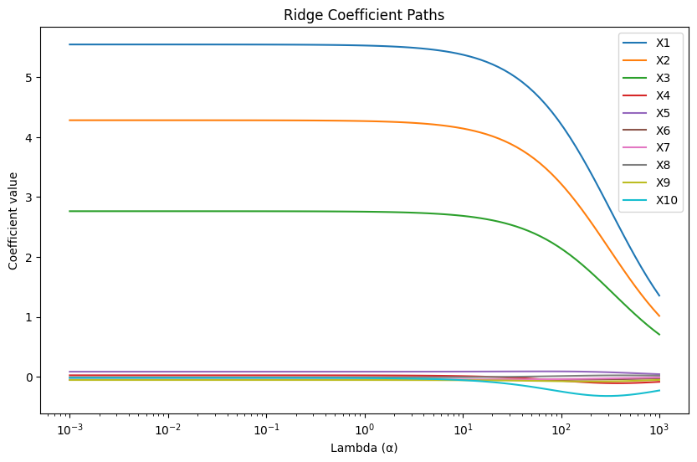
Ridge Regression
Ridge regression was applied using cross-validation to select the optimal regularization parameter. The method shrinks coefficient estimates toward zero, reducing variance and improving stability while retaining all predictors in the model.

Slide 14
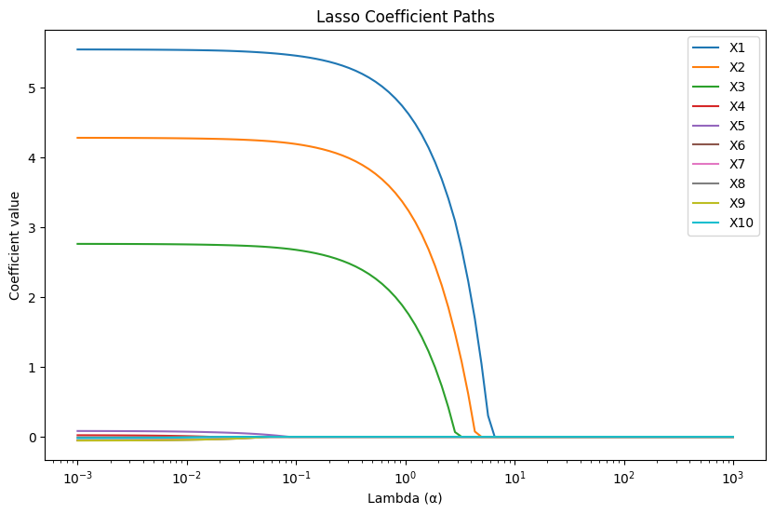
Lasso Regression
Lasso regression performs automatic variable selection by shrinking some coefficients exactly to zero, successfully removing irrelevant predictors.

Slide 15
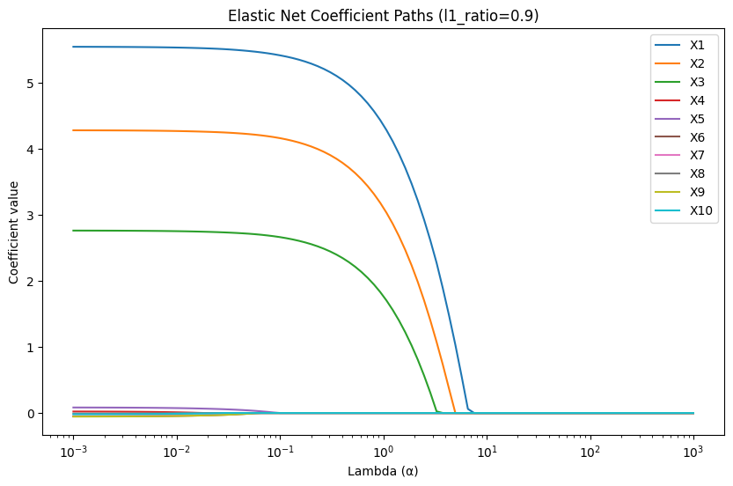
Elastic Net Regression
Elastic Net combines Lasso and Ridge penalties, achieving a balance between sparsity and coefficient stability in the presence of correlated variables.

Slide 16
03
NON-LINEAR REGRESSION AND BIAS-VARIANCE EXPERIMENT

Slide 17
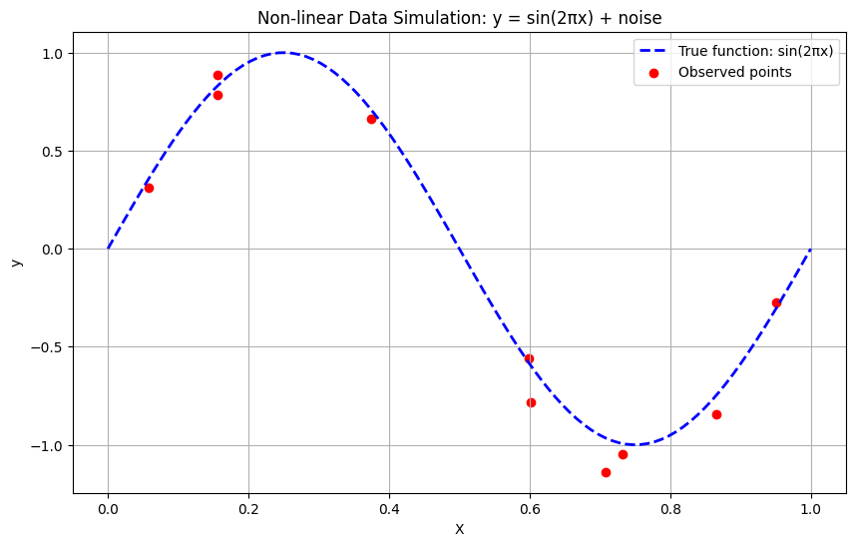
Data Simulation (Non-Linear Case)
To study nonlinear behavior, we simulated data from a non-linear generating function y=sin(2πx)+ε with a small sample size. The observed points deviate from the true function due to noise, making model estimation more challenging.

Slide 18
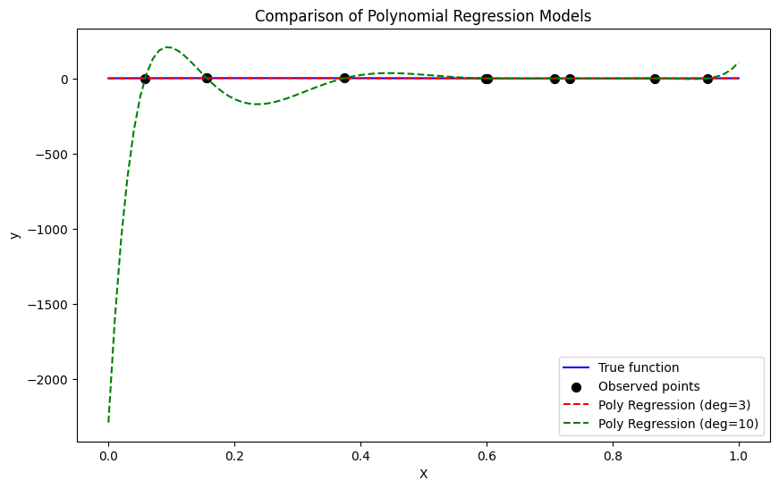
Polynomial Regression
A low-degree polynomial provides a smooth approximation of the true function but underfits the data.
In contrast, a degree-10 polynomial interpolates all observations, achieving near-zero training error but exhibiting strong overfitting and high variance.

Slide 19
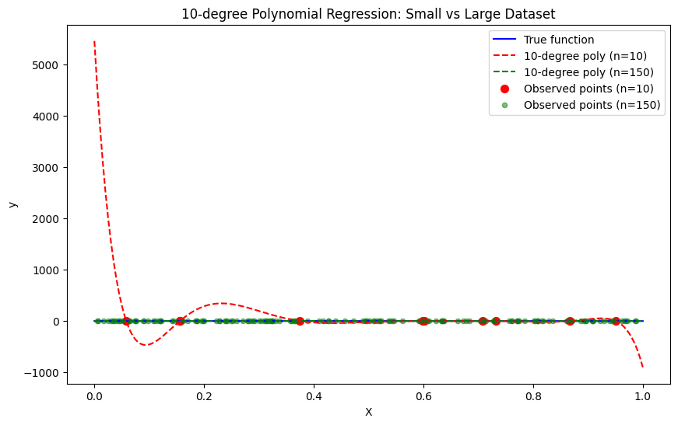
Effect of Sample Size
When the same high-degree polynomial model is fitted on a larger dataset, the fitted curve becomes smoother and less extreme. This shows that increasing the sample size reduces variance and mitigates overfitting in complex models.

Slide 20
Non-linear Models
Model complex relationships beyond linear assumptions
Capture curved and non-monotonic patterns in data
Used to study model flexibility and overfitting
Analyze the bias–variance trade-off
Compare generalization vs training performance
Methods used:
Polynomial Regression.
Spline Regression.
LOESS (Local Regression)

Slide 21
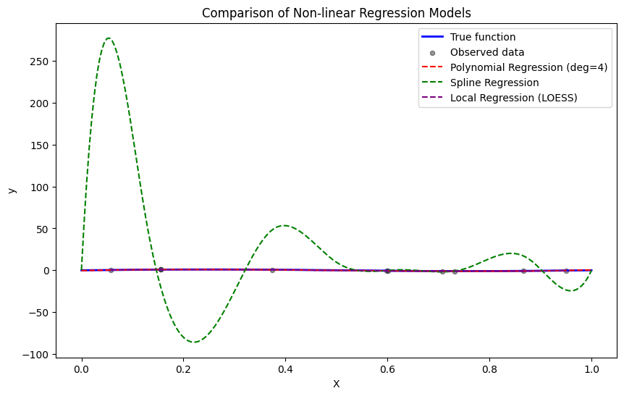
Non-linear Models Comparison

Slide 22
Non-linear Models Comparison
Polynomial Regression (degree 4): Smooth and stable, closely follows the true function; reasonable train MSE; cannot capture small oscillations.
Spline Regression (cubic B-spline, df=10): Extremely flexible; overfits small datasets; unrealistic fluctuations; near-zero train MSE.
LOESS (Local Regression, frac=0.25): Smooth and accurate. In this specific plot, the purple line stays very close to the true function.
Key takeaway:
For small datasets or relatively smooth functions, moderate-degree polynomial regression is preferred.
Spline and LOESS require more data or smoothing/regularization to avoid overfitting.

Slide 23
04
Conclusion

Slide 24
Conclusion
Data Simulation: Synthetic datasets were generated using linear and non-linear functions, allowing controlled experiments to study model behavior.
Linear Regression: Fitted models successfully recovered the main signal; significant predictors matched the strong coefficients in the generating function. Residual analysis identified potential outliers and high-leverage points affecting model stability.
Shrinkage and Regularization: Ridge, Lasso, and Elastic Net improved model stability and controlled overfitting. Lasso enabled feature selection, while cross-validation helped find optimal regularization parameters.

Slide 25
Conclusion
Non-linear Regression: Polynomial regression provided the most stable and realistic approximation for small datasets. Spline and LOESS models were overly flexible, leading to overfitting and unrealistic predictions.
Bias–Variance Trade-off: Small datasets with high-degree models demonstrated high variance (overfitting), while larger datasets reduced overfitting and improved generalization.
Overall: The assignment highlighted the importance of matching model complexity to data size and structure, choosing appropriate regularization techniques, and performing diagnostics to ensure reliable predictions.

Slide 26

Thanks!
Do you have any questions?

